Slide 1
AI VIRTUAL MOUSE
Jomin K Mathew
MCA421

Slide 2
Contents
Introduction.
Objective.
Related Works.
Methodology.
Conclusion.
Future Works.

Slide 3
Introduction
AI virtual mouse system that makes use of the hand gestures and hand tip detection for performing mouse functions in the computer using computer vision.
The main objective of this system is to perform computer mouse cursor functions and scroll function using a web camera or a built-in camera in the computer instead of using a traditional mouse device.
In this system, the web camera captures and then processes the frames that have been captured and then recognizes the various hand gestures and hand tip gestures and then performs the particular mouse function.
Python programming language is used for developing the AI virtual mouse system.

Slide 4
Objective
The main objective of AI virtual mouse system is to develop an alternative to the regular and traditional mouse system to perform and control the mouse functions.
This can be achieved with the help of a web camera that captures the hand gestures and hand tip.
Then processes these frames to perform the particular mouse function such as left click, right click, and scrolling function.

Slide 5

Related Works
Sl no | Title with Publisher | Year of Publisher | Pros | Cons
1 | Chaithanya C, Lisho $omas, Naveen Wilson, and Abhilash SS - “Virtual Mouse Using Hand Gesture”, IEEE. | 2018 | The model detection is based on colors. | Only few mouse functions are performed.
2 | Vinay Kr. Pasi, Saurabh Singh, and Pooja Kumari - “Cursor Control using Hand Gestures”, IEEE. | 2016 | Perform different functions of the mouse. | It depends on various colors to perform mouse functions.

Slide 6
Sl no | Title with Publisher | Year of publisher | Pros | Cons
3 | Monika B. Gandhi, Sneha U. Dudhane, and Ashwini M. Patil - “Cursor Control System Using Hand Gesture Recognition”, IEEE. | 2013 | Recognize the hand gestures and control the computer/laptop according to those gestures. | Stored frames are needed to be processed for hand segmentation and skin pixel detection
4 | Dung-Hua Liou, ChenChiung Hsieh, and David Lee – “A Real-Time Hand Gesture Recognition System Using Motion History Image”, IEEE. | 2010 | Adaptive skin color model and motion history image. | Complicated hand gestures
5 | Quam(Data Glow),”Hardware based system”. | 1990 | Higher accuracy | Difficult to perform some of the gesture controls using the system.

Slide 7
Methodology
Python programming language is used for developing the AI virtual mouse system.
OpenCV which is the library for computer vision is used in the AI virtual mouse system.
The MediaPipe package for tracking of the hands and for tracking the tip of the hands.
PyAutoGUI package were used for moving around the window screen of the computer for performing functions such as left click, right click and scrolling functions.

Slide 8
The Camera Used in the AI Virtual Mouse System.
The AI virtual mouse system is based on the frames that have been captured by the webcam in a laptop or PC. By using the Python computer vision library OpenCV, the video capture object is created and the web camera will start capturing video. The web camera captures and passes the frames to the AI virtual system.
Capturing the Video and Processing.
The AI virtual mouse system uses the webcam where each frame is captured till the termination of the program. The video frames are processed from BGR to RGB color space to find the hands in the video frame.

Slide 9
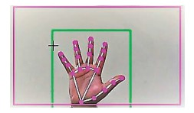
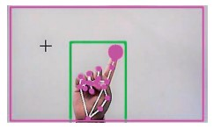
Rectangular Region for Moving through the Window.
The AI virtual mouse system makes use of the transformational algorithm, and it converts the coordinates of fingertip from the webcam screen to the computer window full screen for controlling the mouse.
Detecting Which Finger Is Up and Performing the Particular Mouse Function.
In this stage, we are detecting which finger is up using the tip Id of the respective finger that we found using the MediaPipe and the respective co-ordinates of the fingers that are up and according to that, the particular mouse function is performed.

Slide 10
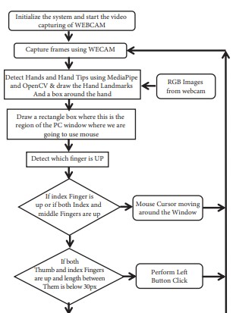
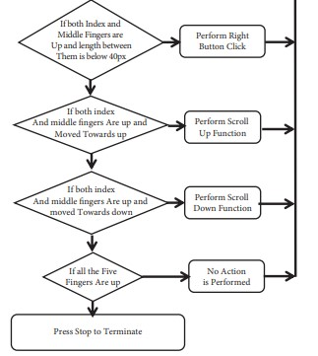
Flowchart

Slide 11
Architecture
AI Virtual System
Recognizing different hand movements
Performing different mouse functions.

Slide 12
Conclusion
The main objective of the AI virtual mouse system is to control the mouse cursor functions by using the hand gestures instead of using a physical mouse.
The proposed system can be achieved by using a webcam or a built-in camera which detects the hand gestures and hand tip and processes these frames to perform the particular mouse functions accurately and fastly.

Slide 13
Future Works
Develop to handle the keyboard functionalities along with the mouse functionalities virtually.

Slide 14
Thank You!

